Slide 1
Cross-Market Product Recommendation
ADVISOR: JIA-LING KOH
PRESENTER: Xiao-Yuan Hung
SOURCE: CIKM’21
DATE: 2022/1/4

Slide 2
Outline
1
Introduction
2
Method
3
Experiment
4
Conclusion
Problem
Target
Data Collection / Analysis

Slide 3
Problem
model are not necessarily effective in a different target market
Only a few studies have been conducted in this area, partly due to the lack of publicly available experimental data

Slide 4
Target
recommending relevant products to users in relatively resource-scarce markets by leveraging data from similar, richer in resource auxiliary markets

Slide 5
Cross-domain and cross-market recommendation
CDR：overlapping users in different domains with the aim of improving the recommendation on the target domain items, using help from the source domain items
CMR the situation is reversed: interactions of different set of users in the source market are leveraged to boost the recommendation for users in the target market.
Notes:
https://arxiv.org/pdf/2103.01696.pdf

Slide 6
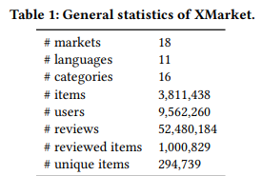
Data Collection
XMarket
From Amazon Product data to crawl data from 18 markets
Matching items by ASIN
One million items, 52 million multilingual review

Slide 7
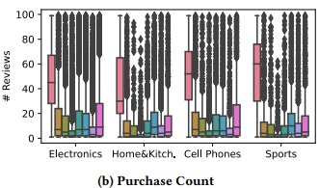
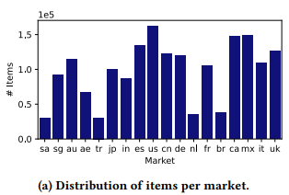
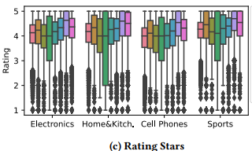
Data Analysis
Saudi Arabia (sa)
Singapore (sg)
Australia (au)
United Arab Emirates (ae)
Turkey (tr)
Japan (jp)
India (in)
Spain (es)
U.S. (us)
China (cn)
Germany (de)
Netherlands (nl)
France (fr)
Brazil (br)
Canada (ca)
Mexico (mx)
Italy (it)
United Kingdom (uk)

Slide 8
Distribution of items
Saudi Arabia (sa)
Singapore (sg)
Australia (au)
United Arab Emirates (ae)
Turkey (tr)
Japan (jp)
India (in)
Spain (es)
U.S. (us)
China (cn)
Germany (de)
Netherlands (nl)
France (fr)
Brazil (br)
Canada (ca)
Mexico (mx)
Italy (it)
United Kingdom (uk)

Slide 9
Purchase count
Saudi Arabia (sa)
Singapore (sg)
Australia (au)
United Arab Emirates (ae)
Turkey (tr)
Japan (jp)
India (in)
Spain (es)
U.S. (us)
China (cn)
Germany (de)
Netherlands (nl)
France (fr)
Brazil (br)
Canada (ca)
Mexico (mx)
Italy (it)
United Kingdom (uk)

Slide 10
Rating Stars
Saudi Arabia (sa)
Singapore (sg)
Australia (au)
United Arab Emirates (ae)
Turkey (tr)
Japan (jp)
India (in)
Spain (es)
U.S. (us)
China (cn)
Germany (de)
Netherlands (nl)
France (fr)
Brazil (br)
Canada (ca)
Mexico (mx)
Italy (it)
United Kingdom (uk)

Slide 11
Mexico giving higher rating

Slide 12
India / Japan giving lower rating

Slide 13
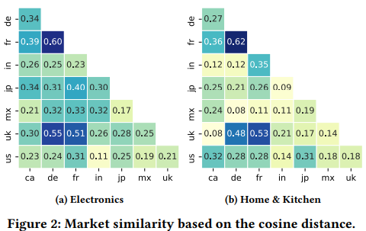
Market similarity

Slide 14
Market similarity - European

Slide 15
Market similarity - North America

Slide 16
Remarks
Different market exhibit different behavior
Cultural biases
Different marketing strategies
Popularity of Amazon in different country
how long it has been doing business

Slide 17
Outline
1
Introduction
2
Method
3
Experiment
4
Conclusion
FOREC system
Input / Output
NMF
MAML
Steps

Slide 18
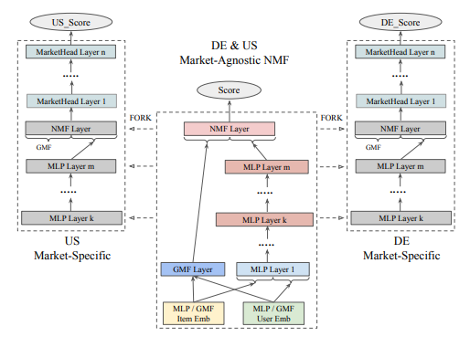
FOREC system

Slide 19
Input／Output
Output
Specific target market
Output
Specific target market
Input
users/items ID of all target markets (DE&US)

Slide 20
General schema of FOREC system
3
3
Pre-training
Forking
Fine-tuning
1
2

Slide 21
FOREC system
Pre-training:Market-Agnostic NMF
Model architecture:
Neural matrix factorization (NMF)
Framework:
Model-Agnostic Meta-Learning (MAML)
Forking
Fine-tuning
1

Slide 22
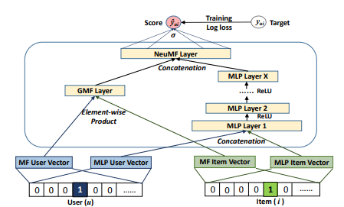
Neural matrix factorization(NMF) model
Input
users/items ID
Output
Predicted score

Slide 23
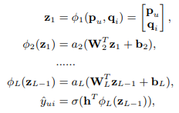
Neural matrix factorization(NMF) model
GMF
MLP
user latent vector p_{u} be P^{T}v_{u}^{U}
item latent vector q_{i} be Q^{T} v_{i} ^{I}
a_{out} ： activation function of output layer
h^{T}：edge weights
W_{x}：weight matrix
B_{x}：bias
a_{x} ： activation function

Slide 24
Neural matrix factorization(NMF) model
p_{u}^{G}：user embedding for GMF
q_{u}^{G}：item embedding for GMF
p_{u}^{M}：user embedding for MLP
q_{u}^{M}：item embedding for MLP
Neural Tensor Network(NTN)

Slide 25
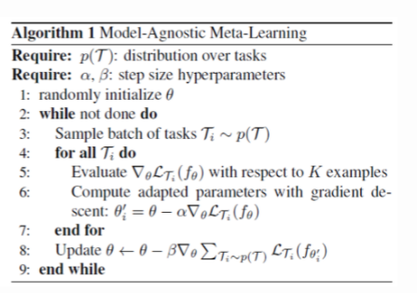
Model-Agnostic Meta-Learning(MAML)

Slide 26
Model-Agnostic Meta-Learning(MAML)

Slide 27
Model-Agnostic Meta-Learning(MAML)

Slide 28
Model-Agnostic Meta-Learning(MAML)

Slide 29
Model-Agnostic Meta-Learning(MAML)
Notes:
https://link.springer.com/article/10.1007/s10994-019-05838-7/figures/1
https://biic.ee.nthu.edu.tw/blog-detail.php?id=24

Slide 30
Pre-training:Market-Agnostic NMF
Pre-training:Market-Agnostic NMF
Model architecture:
Neural matrix factorization (NMF)
Framework:
Model-Agnostic Meta-Learning (MAML)
Forking
Fine-tuning
1

Slide 31
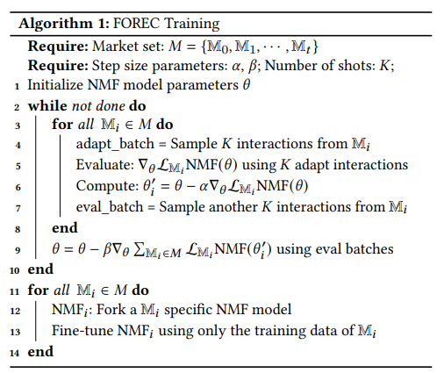
Pre-training:Market-Agnostic NMF
1

Slide 32
Pre-training:Market-Agnostic NMF
Input
users/items embedding of all target markets (DE&US)

Slide 33
Pre-training:Market-Agnostic NMF
Loss function : binary cross entropy

Slide 34
Pre-training:Market-Agnostic NMF
Loss function : binary cross entropy

Slide 35
Forking: Market-Specifc Model Construction
Pre-training
Forking
Fine-tuning
2

Slide 36
Forking: Market-Specifc Model Construction

Slide 37
Forking: Market-Specifc Model Construction
To maximize the reusability of general parameters
freeze layers up to layer k of the MLP network (1  ≤ k ≤ m)
the main body of the network barely changes
all the adaptation happens in the head layers of the network
add n MarketHead layers on top of the network
to increase the network’s capacity
balancing between the general market and target market-specifc parameters after the fnal fine-tuning

Slide 38
Fine-tuning: Final Training on the Target Market
3
3
Pre-training
Forking
Fine-tuning

Slide 39
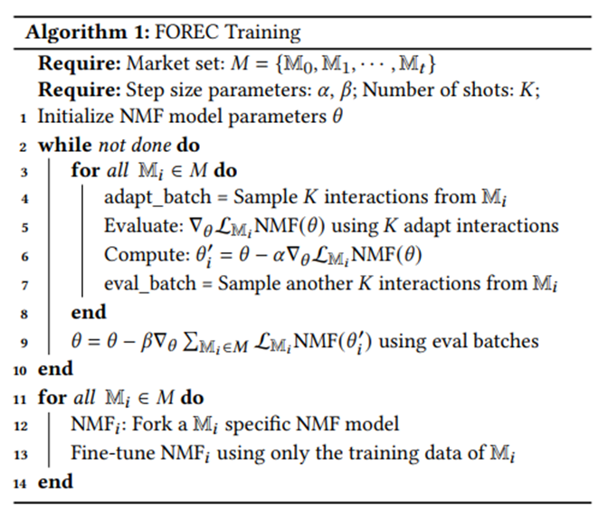
Fine-tuning: Final Training on the Target Market
using only the data from the target market
facilitates the maintenance of the entire network

Slide 40
Outline
1
Introduction
2
Method
3
Experiment
4
Conclusion

Slide 41
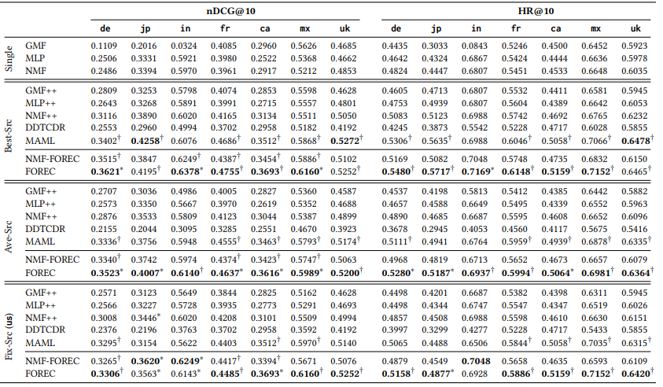

Slide 44
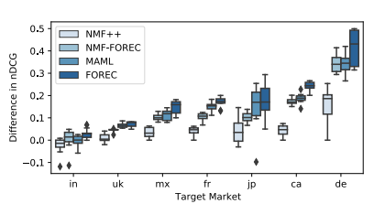
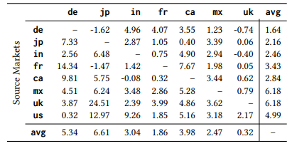
relative percentage improvement of FOREC compared to MAML.

Slide 45
Outline
1
Introduction
2
Method
3
Experiment
4
Conclusion

Slide 46
conclusion
CDR models are not necessarily suitable for the market adaptation problem setting
Proposing a novel neural architecture for market-adaptation(FOREC)
Collecting a real-world pragmatic large-scale cross-market and cross-lingual product review dataset.(XMarket )

